Slide 1
YEKBUN Section

Slide 2



YEKBUNTV

Slide 3






TV
YEKBUN
15 Days Free Music and Video
Derbasbûn
Qeydkirin

Slide 4






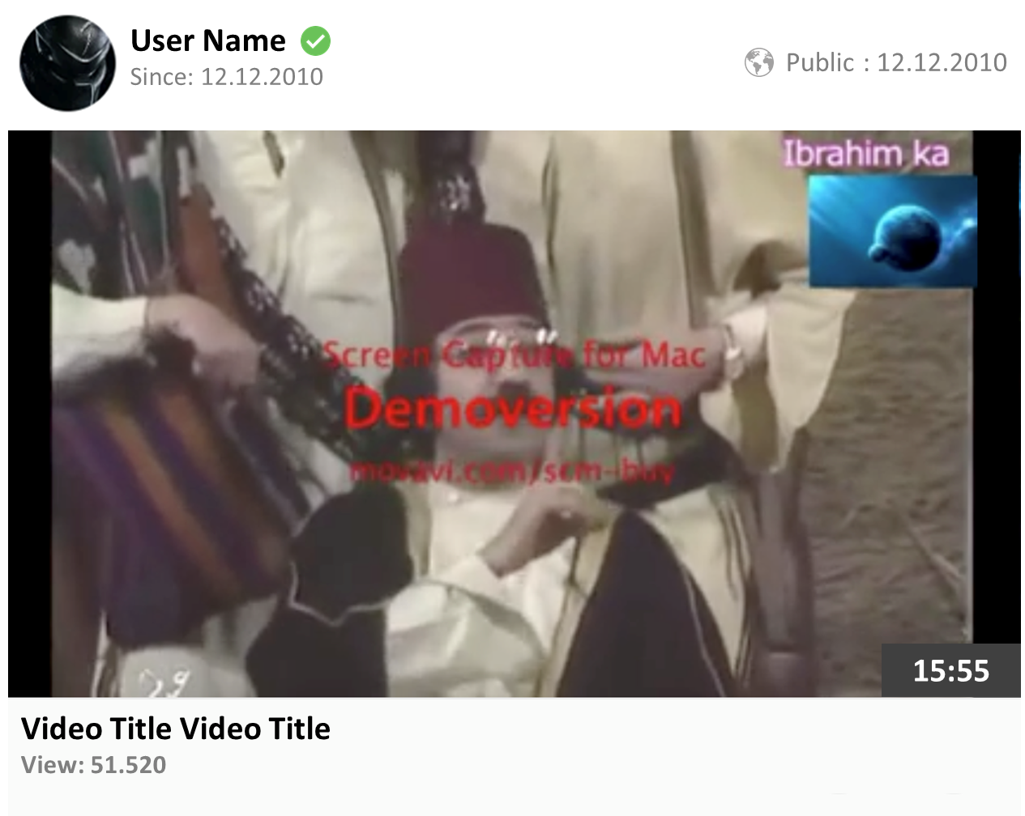

almost viewed
Yekbun Video
Zarok Video
Options
My Videos
Latest Uploads
View Later
History
Catgeory
Live Stream
Yekbun Video
More
Movies
Latest Video Clips
Artist
Dance
My Playlist
Funny Videos
Music Playlist
More
My Subscribe
Funny Videos
Funny Videos

Slide 5






My Best Videos
Yekbun Video
Zarok Video
Options
My Videos
My Live Stream
View Later
Video title Video title
History
Public : 12.12.2010
Catgeory
Live Stream
User Name
Since: 12.12.2010
Yekbun Video
15:55
1.500.258 2.500
Movies
My Uploads
Artist
Video title Video title
Dance
Public : 12.12.2010
My Playlist
Funny Videos
User Name
Since: 12.12.2010
15:55
1.500.258 2.500
Music Playlist
More
My Subscribe
Funny Videos
Funny Videos

Slide 6
View later
Video title Video title
Public : 12.12.2010
Yekbun Video
User Name
Since: 12.12.2010
15:55
1.500.258 2.500
Zarok Video
Video title Video title
Public : 12.12.2010
Options
My Videos
View Later
User Name
Since: 12.12.2010
15:55
1.500.258 2.500
History
Video title Video title
Public : 12.12.2010
Catgeory
Live Stream
Yekbun Video
User Name
Since: 12.12.2010
15:55
1.500.258 2.500
Movies
Artist
Dance
My Playlist
Funny Videos
Music Playlist
More
My Subscribe
Funny Videos
Funny Videos

Slide 7

Video history
Video title Video title
Public : 12.12.2010
User Name
Since: 12.12.2010
Yekbun Video
15:55
1.500.258 2.500
Zarok Video
Video title Video title
Public : 12.12.2010
Options
My Videos
User Name
Since: 12.12.2010
View Later
15:55
1.500.258 2.500
History
Video title Video title
Public : 12.12.2010
Catgeory
Live Stream
Yekbun Video
User Name
Since: 12.12.2010
15:55
1.500.258 2.500
Movies
Artist
Music history
Dance
SongTitleSongTitle
SongTitleSongTitle
SongTitleSongTitle
SongTitleSongTitle
SongTitleSongTitle
My Playlist
Funny Videos
Music Playlist
My Subscribe
Artist history
Funny Videos
SongTitleSongTitle
SongTitleSongTitle
SongTitleSongTitle
SongTitleSongTitle
SongTitleSongTitle
Funny Videos
Funny Videos
Funny Videos

Slide 8
almost viewed
Yekbun Video
Zarok Video
Options
My Videos
View Later
Latest Stream
History
Catgeory
Live Stream
Yekbun Video
Movies
Artist
Past Streams
Dance
My Playlist
Funny Videos
Music Playlist
More
My Subscribe
Funny Videos
Funny Videos

Slide 9
almost viewed
Yekbun Video
Zarok Video
Options
My Videos
View Later
Latest Uploaded
History
Catgeory
Live Stream
Yekbun Video
Movies
Artist
Best Rated
Dance
My Playlist
Funny Videos
Music Playlist
More
My Subscribe
Funny Videos
Funny Videos

Slide 10
almost viewed
Yekbun Video
Zarok Video
Options
My Videos
View Later
Uploaded
History
Catgeory
Live Stream
Yekbun Video
Movies
Artist
Past Streams
Dance
My Playlist
Funny Videos
Music Playlist
More
My Subscribe
Funny Videos
Funny Videos

Slide 11
almost viewed
Yekbun Video
Zarok Video
Options
My Videos
View Later
Latest Artist
History
SongTitleSongTitle
SongTitleSongTitle
SongTitleSongTitle
SongTitleSongTitle
SongTitleSongTitle
Catgeory
Live Stream
Yekbun Video
Movies
Artist
Artist
SongTitleSongTitle
SongTitleSongTitle
SongTitleSongTitle
SongTitleSongTitle
SongTitleSongTitle
Dance
My Playlist
Funny Videos
Music Playlist
My Subscribe
Funny Videos
Funny Videos

Slide 12
almost viewed
Yekbun Video
Zarok Video
Options
My Videos
View Later
Latest Music Upload
History
SongTitleSongTitle
SongTitleSongTitle
SongTitleSongTitle
SongTitleSongTitle
SongTitleSongTitle
Catgeory
Live Stream
Yekbun Video
Movies
Artist
Kurmanci
SongTitleSongTitle
SongTitleSongTitle
SongTitleSongTitle
SongTitleSongTitle
SongTitleSongTitle
Dance
My Playlist
Funny Videos
Music Playlist
My Subscribe
Sixani
Funny Videos
SongTitleSongTitle
SongTitleSongTitle
SongTitleSongTitle
SongTitleSongTitle
SongTitleSongTitle
Funny Videos

Slide 13
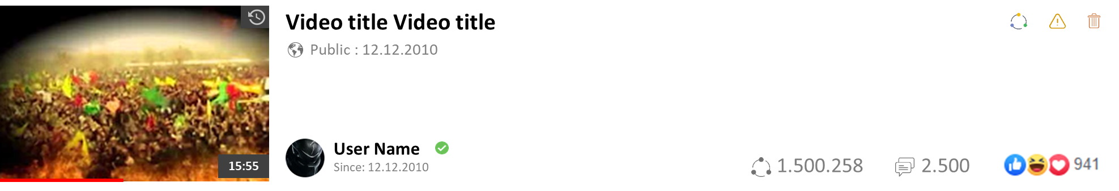




Playlist Name
Total 20 songs
Public 12.12.2010
1.500.258 2.500
Play All
Yekbun Video
Zarok Video
Options
My Videos
View Later
History
Catgeory
Live Stream
Yekbun Video
Movies
Artist
Dance
My Playlist
Funny Videos
Music Playlist
My Subscribe
Funny Videos
Funny Videos

Slide 14
Zarok Section

Slide 15
Yekbun Video
Zarok Video
Options
Latest Uploads
My Videos
View Later
History
Categorys
Funny Videos
Funny Videos
More
Funny Videos
Latest Video Clips
More

Slide 16
My Best Videos
Yekbun Video
Zarok Video
Options
My Videos
My Live Stream
View Later
Video title Video title
History
Public : 12.12.2010
Catgeory
Live Stream
User Name
Since: 12.12.2010
Yekbun Video
15:55
1.500.258 2.500
Movies
My Uploads
Artist
Video title Video title
Dance
Public : 12.12.2010
My Playlist
Funny Videos
User Name
Since: 12.12.2010
15:55
1.500.258 2.500
Music Playlist
More
My Subscribe
Funny Videos
Funny Videos

Slide 17
View later
Video title Video title
Public : 12.12.2010
Yekbun Video
User Name
Since: 12.12.2010
15:55
1.500.258 2.500
Zarok Video
Video title Video title
Public : 12.12.2010
Options
My Videos
View Later
User Name
Since: 12.12.2010
15:55
1.500.258 2.500
History
Video title Video title
Public : 12.12.2010
Catgeory
Live Stream
Yekbun Video
User Name
Since: 12.12.2010
15:55
1.500.258 2.500
Movies
Artist
Dance
My Playlist
Funny Videos
Music Playlist
More
My Subscribe
Funny Videos
Funny Videos

Slide 18
View history
Video title Video title
Public : 12.12.2010
User Name
Since: 12.12.2010
Yekbun Video
15:55
1.500.258 2.500
Zarok Video
Video title Video title
Public : 12.12.2010
Options
My Videos
User Name
Since: 12.12.2010
View Later
15:55
1.500.258 2.500
History
Video title Video title
Public : 12.12.2010
Catgeory
Live Stream
Yekbun Video
User Name
Since: 12.12.2010
15:55
1.500.258 2.500
Movies
Artist
SongTitleSongTitle
SongTitleSongTitle
SongTitleSongTitle
SongTitleSongTitle
SongTitleSongTitle
Dance
My Playlist
Funny Videos
Music Playlist
My Subscribe
Funny Videos
Funny Videos

